Slide 1

DEPARTMENT OF ELECTRONICS AND COMMUNICATION ENGINEERING
“INVESTMENT AND SALES PREDICTION USING MACHINE LEARNNG”

Slide 2
Contents
Software and Hardware knowledge acquired
Introduction of the project
Aim of the project
Theoretical background
Design and implementation
Features
Results
Discussions
Conclusion
References

Slide 3
Software knowledge acquired
Python
Anaconda(Jupyter)
NumPy
Pandas
Matplotlib
Linear Regression
Scikit-Learn

Slide 4
Machine learning: Is a branch of artificial intelligence and computer science which focuses on the use of data and algorithms to imitate the way that humans learn, gradually improving its accuracy.
Pandas: It used for data analysis tasks in python. It provides high performance data manipulation.
NumPy: It is a python library used for working with a array.
Matplotlib: To visualize the data or to plot the data(graph)(image).

Slide 5
Introduction of the project
Investment and sales prediction using machine learning is an important area of research and application in the finance industry. The ability to accurately predict investment trends and sales patterns can help businesses make informed decisions about their future investments and sales strategies.

Slide 6
Aim of the Project
To implement the concept of machine learning to predict the Investment and sales of the company
To reduce the loss burden of Investors.
To develop a predictive model that can accurately forecast future sales and investment performance based on historical data and other relevant factors.
The investment and sales prediction model can be used to guide important business decisions, such as resource allocation, budgeting, and strategic planning.

Slide 7
Linear Regression:
Linear regression is a quiet and simple statistical regression method used for predictive analysis and shows the relationship between the continuous variables.
Linear regression shows the linear relationship between the independent variable (X-axis) and the dependent variable (Y-axis), consequently called linear regression.
If there is a single input variable (x), such linear regression is called simple linear regression.
And if there is more than one input variable, such linear regression is called multiple linear regression.
The linear regression model gives a sloped straight line describing the relationship within the variables.

Slide 8
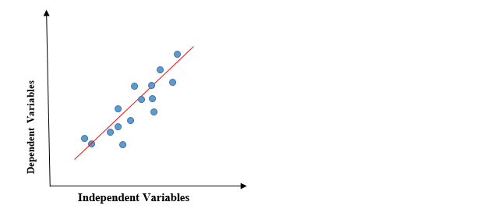
Fig: Graph of Linear regression
The above graph presents the linear relationship between the dependent variable and independent variables.
When the value of x (independent variable) increases, the value of y (dependent variable) is likewise increasing.
The red line is referred to as the best fit straight line. Based on the given data points, we try to plot a line that models the points the best.

Slide 9

To calculate best-fit line linear regression uses a traditional slope-intercept form
y= Dependent Variable.
x= Independent Variable.
a0= intercept of the line.
a1 = Linear regression coefficient.

Slide 10
Design and Implementation
Dataset Collection
Data Pre-processing and formatting
Defining and Training Model
Testing the model
Output
Fig1: Methodology for fitting ML model

Slide 11
Features
TV
Response
Sales
Radio
Response
Response
Newspaper
Fig2:Relationship between sales and advertising media

Slide 12
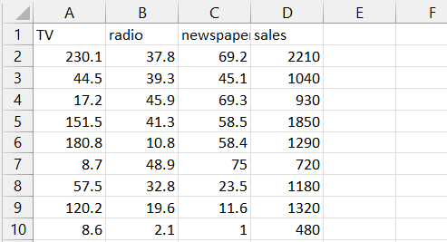

Slide 13
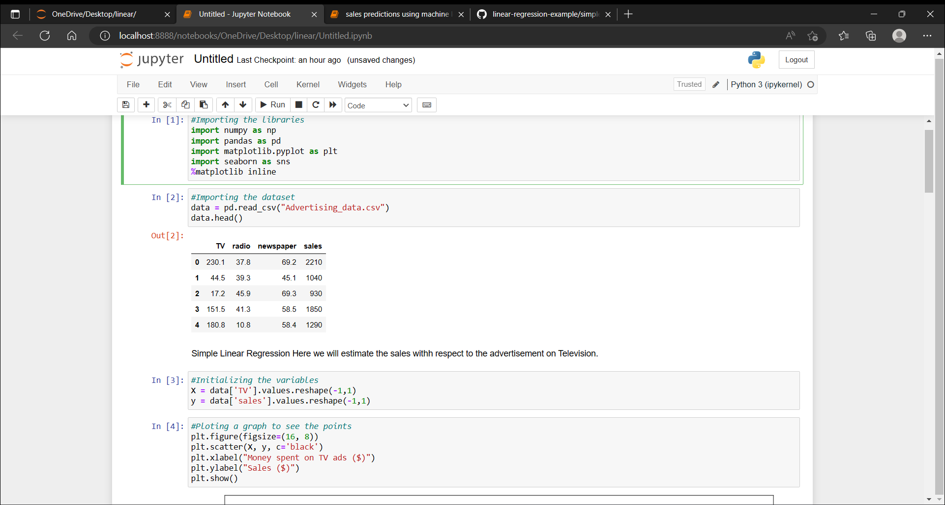
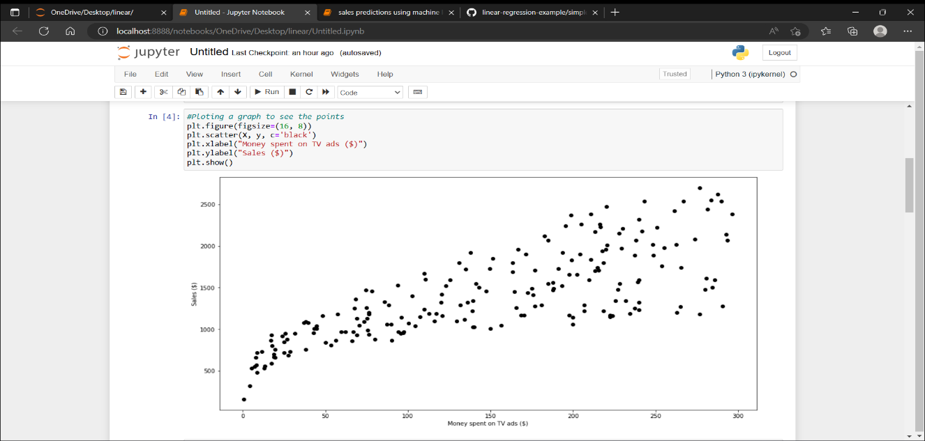
Code

Slide 14
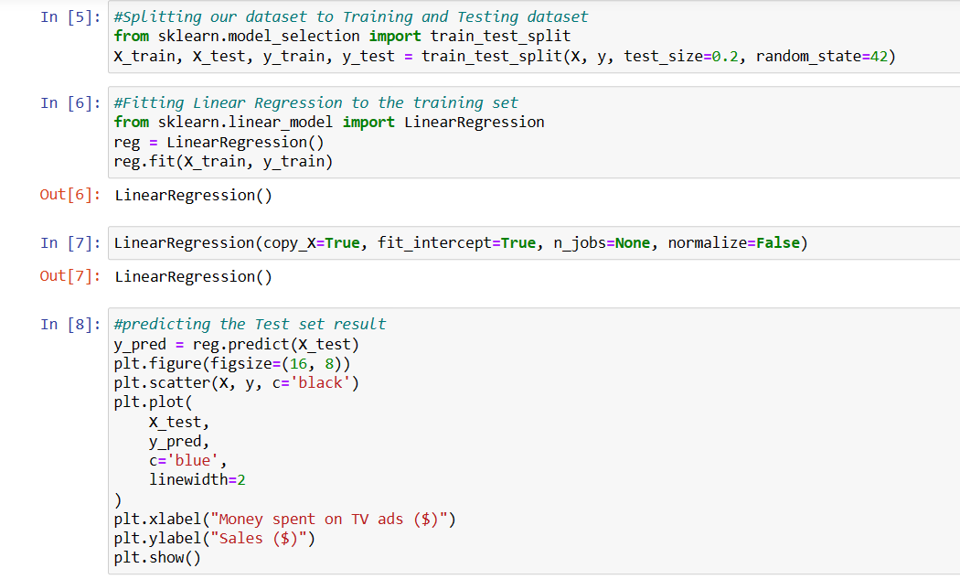
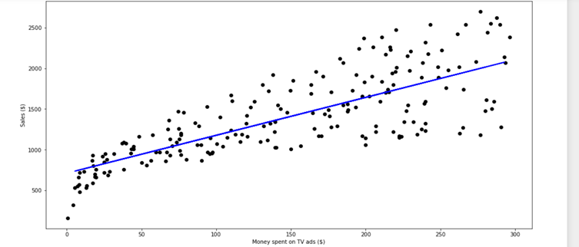

Slide 15
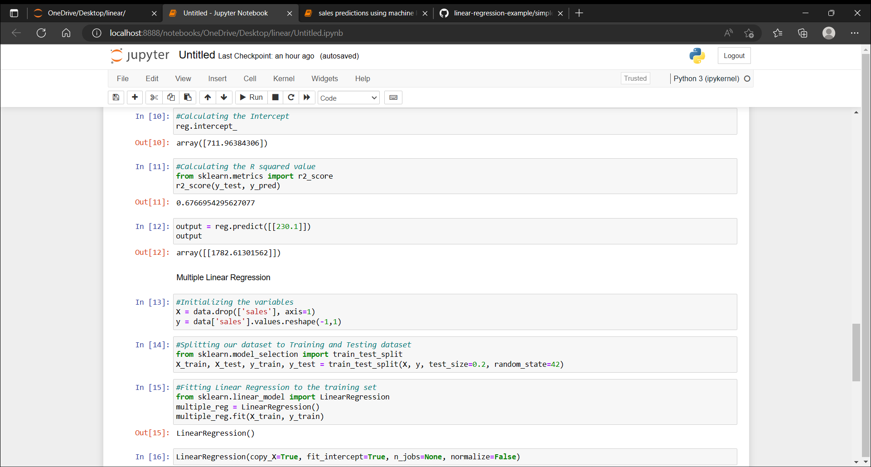
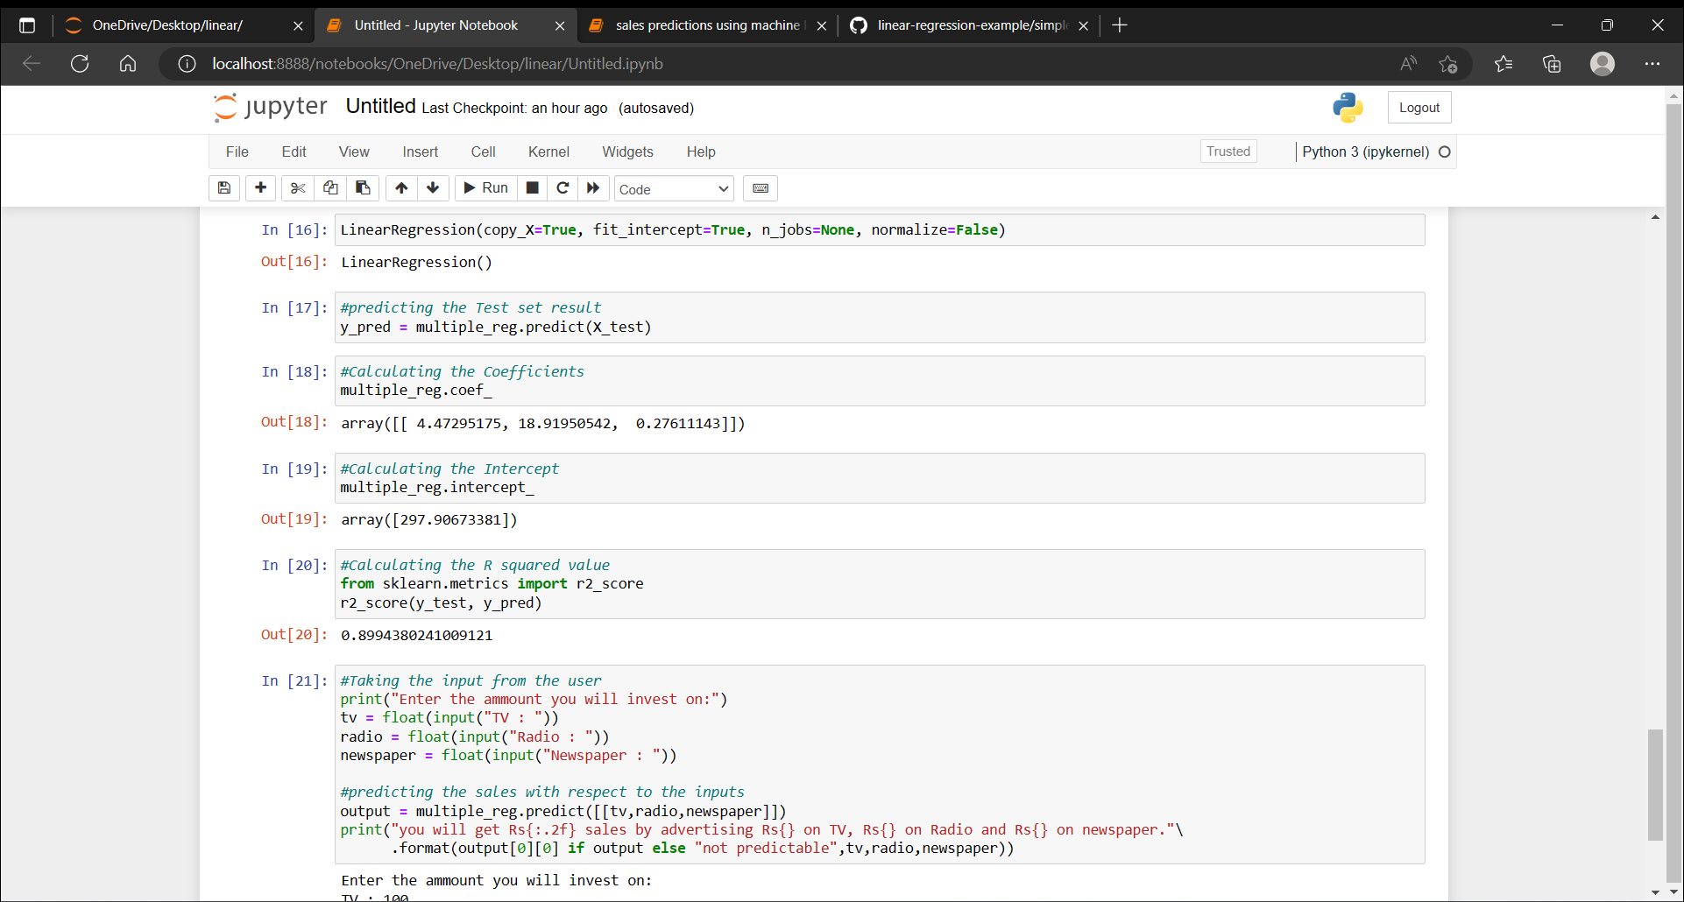

Slide 16
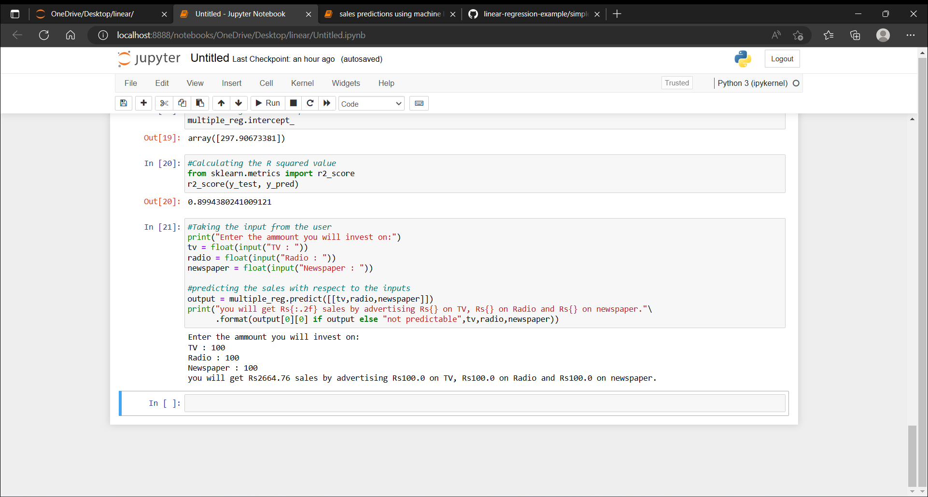

Slide 17
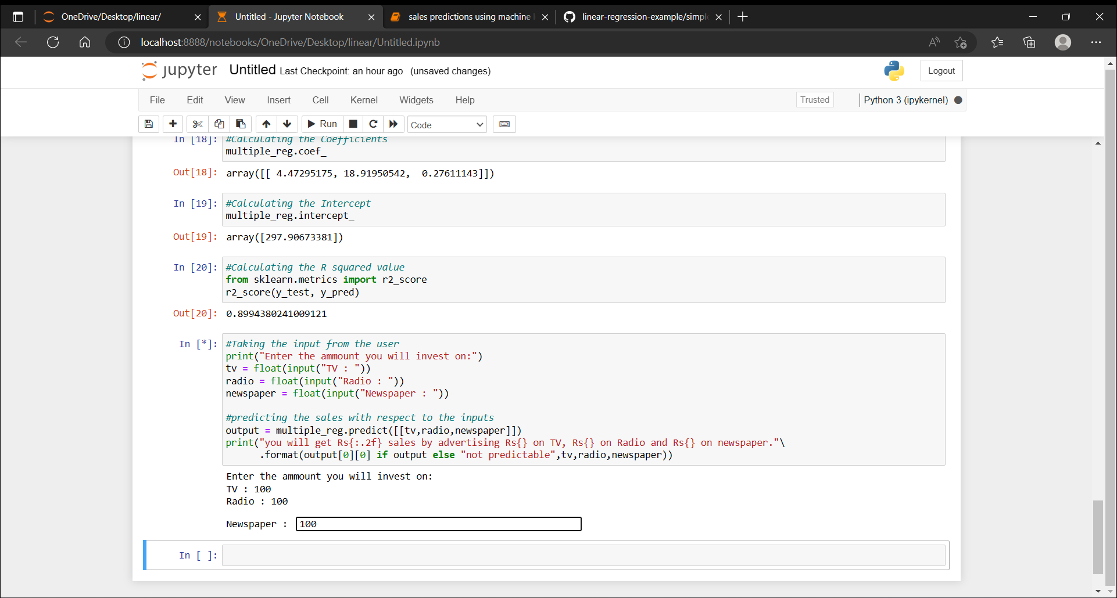
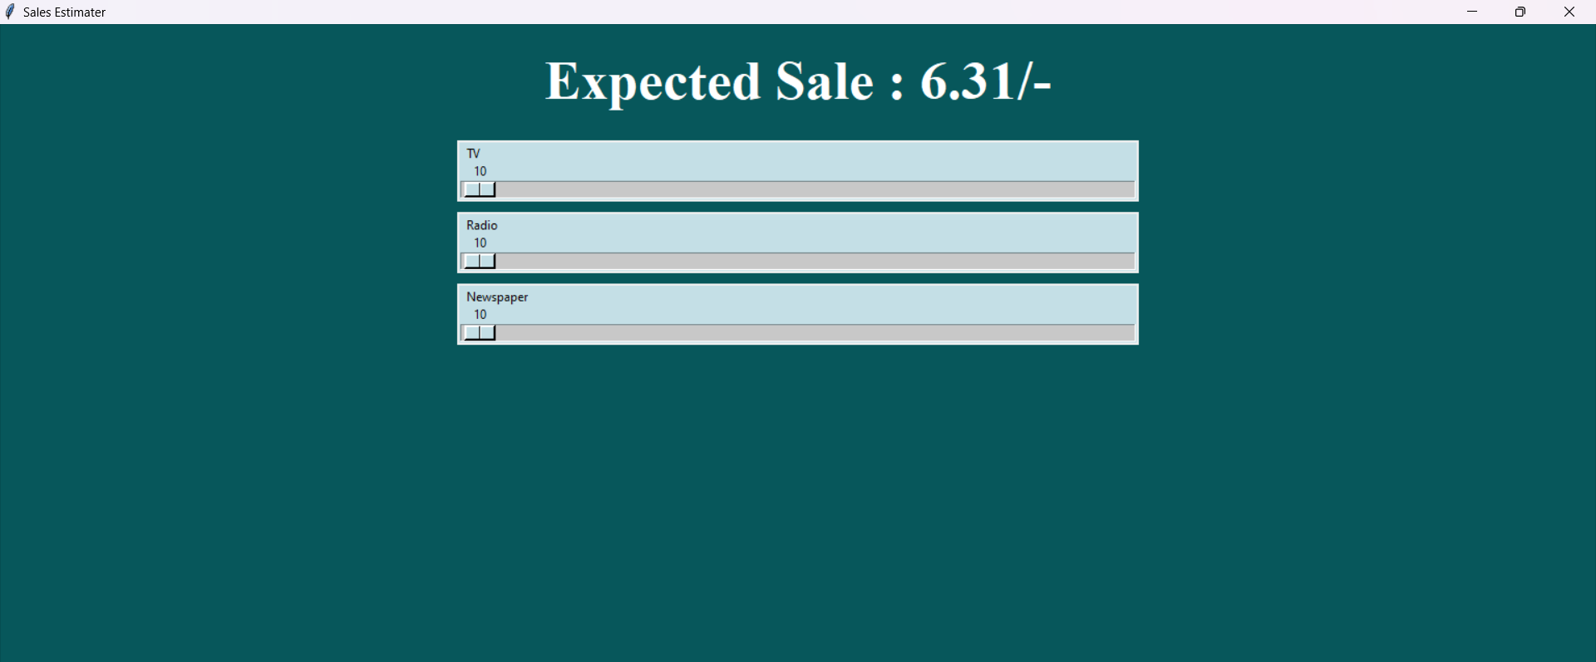
Result

Slide 18
Conclusion
Project typically includes a summary of the project's findings, implications for the business or industry, and suggestions for future work.
It include a summary of the accuracy of the predictive model and the insights gained from the analysis of the data.
The model can be used to guide decision-making or improve operations.
It also suggest areas for future work or research, such as additional data sources that could be incorporated into the model or more advanced machine learning techniques that could be used to improve the accuracy of the predictions.

Slide 19
References
[1] Cleveland, W.S. Robust locally weighted regression and smoothing scatterplots. Journal of the American Statistical Association, 74, 368 (Dec. 1979), 829-836.
[2] Diehr, G. and Hoflin, D.R. Approximating the distribution of the sample R2 in best s Marquardt, D.W. Generalized inverses, ridge regression, biased linear estimation, and nonlinear estimation. Technometrics, 12, 3 (Aug. 1970), 591–612.
[3] Mitchell, T. Machine Learning. WCB McGraw-Hill, 1997. 81-82.
[4] Ohtani, K. Bootstrapping R2 and adjusted R2 in regression analysis. Economic Modelling, 17, 4 (2000), 473–483.

Slide 20
THANK YOU

